Slide 2
Resource Virtualization
CPU Virtualization
Memory Virtualization
I&O Virtualization

Slide 3
CPU Virtualization
Interpretation and Binary Translation
Virtualizable ISAs

Slide 5
Instruction Set Architecture (ISA)
Typically, the architecture of a processor defines:
A set of storage resources (e.g., registers and memory)
A set of instructions that manipulate data held in storage resources
The definition of the storage resources and the instructions that manipulate data are documented in what is referred to as Instruction Set Architecture (ISA)
Two parts in the ISA are important in the definition of VMs:
1. User ISA: visible to user programs
2. System ISA: visible to supervisor software (e.g., OS)

Slide 6
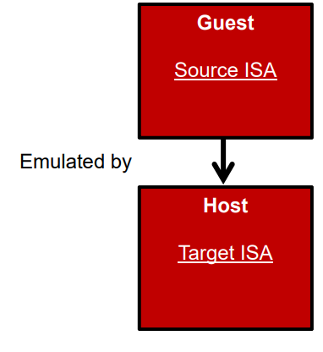
Emulation
Emulation is the process of implementing the interface and functionality of one system (or subsystem) on a system (or subsystem) having different interface and functionality.
In other words, emulation allows a machine implementing one ISA (the target), to reproduce the behaviour of a software compiled for another ISA (the source)
Emulation can be carried out using:
1. Interpretation
2. Binary translation

Slide 7
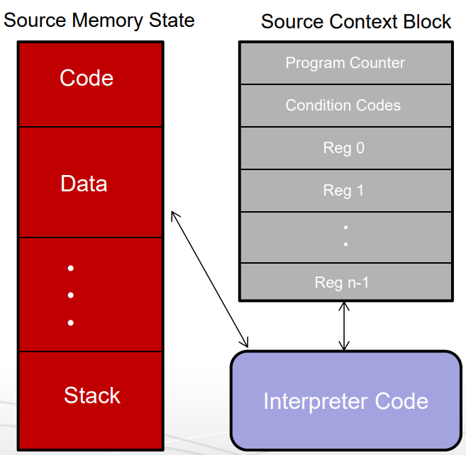
Basic Interpretation
Interpretation involves a 4-step cycle (all in software):
Fetching a source instruction
Analyzing it
Performing the required
operation
4. Then fetching the next
source instruction

Slide 8
Decode-And-Dispatch
A simple interpreter, referred to as decode-and-dispatch, operates by stepping through the source program (instruction by instruction) reading and modifying the source state
Decode-and-dispatch is structured around a central loop that decodes an instruction and then dispatches it to an interpretation routine
It uses a switch statement to call a number of routines that emulate individual instructions

